Slide 1
“…By this everyone will know that you are my disciples, if you love one another.” John 13:35
🔑 Message Series -
OVERALL QUESTION: What does Love “LOOK” like from the outside?
How will someone see that you “love one another”?
Today - # 2: Wise Love
Galatians 6
👉 Get your Journal out or you phone to take notes!

Slide 2
Opening Prayer
Take us on a journey
Open our ears and hearts
Stop us from being offended
Convict us to align with you
Help us to grow!
Expand your kingdom, thy will be done!

Slide 3
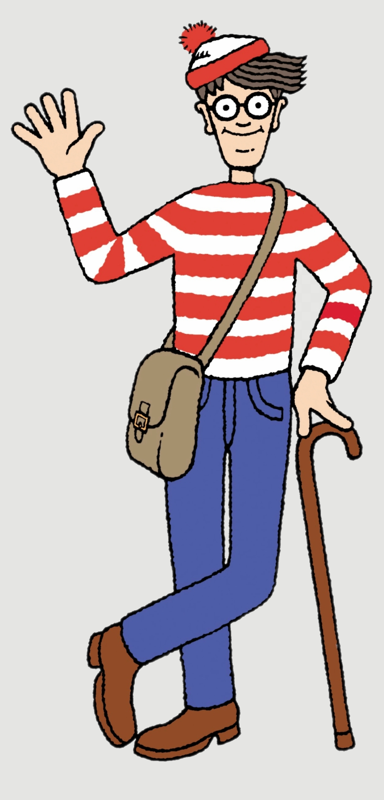
Every message in the Series will land the same way
Gospel, application, accountability.
A reference to Jesus and His good news
One clear practical application
One action to take this week
One person to share it with that was not here today
One close friend to spur you on and support each other in this task
Each will only help you grow stronger – no condemnation intended. (If you are struggling let me know.)
But… get comfortable with being uncomfortable
Love One Another | Wise Love | Galatians 6

Slide 4
Review Last Message
Who can remember what it was about?
🐘

Slide 5
Review: Message 1
Speech is a 2-Sided Coin: Heads - Build people up, Tails - Tame the tongue, stop gossip.
Every word you speak is either
building the ‘Church’...
or burning it down. (Eph 4/James 3)
Challenge: Have you started outdoing one another in giving others honour? (Rom 12)
Love One Another | Wise Love | Galatians 6

Slide 6
Today: One Coin, One Truth—
We Must Have Wise Love
Two sides of the same coin
Galatians 6:1-10
(In your small groups go over this again
SOS: Say Obey Share & Use Your Coin)

Slide 7
¹ Brothers, if anyone is caught in any transgression, you who are spiritual should restore him in a spirit of gentleness. Keep watch on yourself, lest you too be tempted. ² Bear one another's burdens, and so fulfill the law of Christ. ³ For if anyone thinks he is something, when he is nothing, he deceives himself. ⁴ But let each one test his own work, and then his reason to boast will be in himself alone and not in his neighbor. ⁵ For each will have to bear his own load.
⁶ Let the one who is taught the word share all good things with the one who teaches. ⁷ Do not be deceived: God is not mocked, for whatever one sows, that will he also reap. ⁸ For the one who sows to his own flesh will from the flesh reap corruption, but the one who sows to the Spirit will from the Spirit reap eternal life. ⁹ And let us not grow weary of doing good, for in due season we will reap, if we do not give up. ¹⁰ So then, as we have opportunity, let us do good to everyone, and especially to those who are of the household of faith.

Slide 8
One Coin – Wise Love - with Two Commands
Heads - Command 1
Tails - Command 2
Bear one another's burdens
(Quite often a group effort)
Each will bear
his/her own load
“Keep on carrying each other’s burdens.”
Present active imperative (2nd person plural)
“For each will bear his own ‘load’.”
“Carry what you should carry in your ‘pack’”
Future active indicative (3rd person singular)
They sound opposite, but together they form mature love.
Love One Another | Wise Love | Galatians 6

Slide 9
What Love Is:
Real Love always costs you something.
Love carries others
Love takes responsibility for ourselves
Both are required
Not either/or
BUT both/and

Slide 10
Side 1 Heads: Burdens
Burden is a “crushing weight”. (Gloss)
Too heavy for one person to “lift with their hands”. (Bear – Gloss)
Crisis | suffering | failure | restoration
Requires help or they will fail if left alone.
Command: Step in. Do not stand back.

Slide 11
Examples of Burdens
Grief and loss
Addiction struggles
Financial crisis
Serious sin & restoration
Broken relationships (e.g. affair, hidden immorality, etc.)

Slide 12
How to Bear Someone's Burden
Listen first!
Pray and walk with them
Step in, don’t stand back
Enter their pain
Give practical help + an emotional presence – as you can…
Restore them gently
Share the weight

Slide 13
Be Wise:
Will it require an individual or a group effort?
Don’t give the Devil a foothold in your life if you are dealing with an area that you too may be tempted.
DRSABC - Tommy Shard, Gary Daily
Warning – When we step in…
We are not to gossip, control, or be prideful – but humble, we too fall from time to time!

Slide 14
But…
Not everything is a burden
There is another side of the coin
Personal responsibility

Slide 15
Side 2 -Tails: Loads
Load is your personal ‘backpack’ (Gloss)
Your assigned responsibilities
Your daily calling
You must carry it
God has given it to you to carry

Slide 16
Examples of Loads
Your relationship and obedience to God
Your attitude to people
Your family
Your work or calling

Slide 17
Some reasons for a load (and good)
We pick up some voluntarily
God’s Loads:
Growth and Maturity – James 1:2-4, Rom 5:3–5, Luk 9:23, 1 Pet 1:6-7
Course Correction (not discipline as in punishment) - Heb 12:6–11
Consequences for our actions (a teaching tool) - 6:7–8
Stewardship and Responsibility- Luke 16:10, Matt 28:18-20,
Preparation for greater things - Moses, David, Joesph, 2 Cor 1:3-4
God teaching us to trust him - 2 Cor 12:9-10
Witnessing - Matt 5:16, 1 Pet 2:12

Slide 18
Command: Carry Your Own Load
No outsourcing obedience
Stop blaming others
Stand before God personally
Own your walk
Identify and correct your mistakes! Learn!

Slide 19
Warning
Don’t turn loads into burdens
Avoid victim mentality. You are a Victor in Christ!
Don’t expect others to carry your calling
Avoid spiritual laziness
Pride by the doer or the receiver will derail this.

Slide 20
The Tension Between Burdens and Loads
Jump in or Stand back?
Love is wise

Slide 21
The Two Extremes to Avoid
Ditch 1: Cold Independence
  “Not my problem” or “I don’t need anyone’s help”
  Fails to carry burdens / Accept help
Ditch 2: Enabling Dependency/Co-Dependency
  “I’ll fix everything for you” / “I’ll let you do everything for me”
  Removes responsibility
👉 Truth: Both are unloving. Unhealthy.
Stand on the road in between

Slide 22
“Delay Action”
Most people act too quickly:
Don’t fix immediately
Ask questions first
Pray before acting
👉 Rule: “Slow down before you step in.”

Slide 23
Diagnostic Questions
Am I helping carry burdens?
Or avoiding people in need?
Am I carrying my own load?
Or expecting others to carry it?

Slide 24
What to say:
Instead of:
  “I’ll take care of that for you”
Ask:
  “What part of this is hardest right now?”
  “What have you tried already?”
  “How can I support you without taking over?”
👉 This builds discernment for you and their confidence.

Slide 25
Ask 3 questions before acting:
1. Is this crushing or carrying?
  Crushing = burden → step in
  Carrying = normal responsibility → step back
2. Are they trying or avoiding?
  Trying → support them
  Avoiding → don’t rescue them. (Is this a repeating pattern?)
3. Will my help strengthen or weaken them?
  Strengthens → do it
  Weakens / creates dependence → don’t

Slide 26
👉 “Help in a way that restores strength, not replaces responsibility.”
👉 “Mature love knows when to step in— and when to step back.”

Slide 27
Best Example: Good News of Jesus Christ
For all have sinned and fallen short of the glory of God. (Rom 3:23)
For the wages of sin is death, but the free gift of God is eternal life in Christ Jesus our Lord. (Rom 6:23)
🪨 Our burden (sin, guilt, judgment) there is NOTHING we can do to fix this!
“The Good News is this:
You have a burden you cannot carry…
and Jesus didn’t tell you to try harder —
He carried it for you.”
Now He calls us to do the same for others
– as we can, in our seasons

Slide 28
Call to Action This Week
Identify one burden to help carry
Identify one load you have been putting off and take responsibility for it
Find someone who you can share this with that was not here today?
Find someone who you can trust to keep you honest with yourself?

Slide 29
Conclusion
“Don’t do for someone what God is expecting them to do!
But always help with what they cannot do alone.”
🎯 Prayer - to hit this bullseye today!

