Slide 1
Sermon Series – “…By this everyone will know that you are my disciples, if you love one another.” John 13:35
Today - Biggest Bang for your Buck

Slide 2
Opening Prayer
Take us on a journey
Stop us from being offended
Convict us to align with you
Bless us and our congregation
Expand your kingdom, thy will be done!

Slide 3
🔑 The Series Flow To A Healthy Church
This isn’t random — it has a progression:
🔹 🐘 🧱 INTERNAL HEALTH
  1–5 → Clean up relationships
  (speech, conflict, forgiveness, gossip)
🔹 CULTURE SHIFT
  6–9 → Build a new way of living
  (service, encouragement, hospitality)
🔹 OUTWARD + MULTIPLICATION
  8, 10–12 → Turn outward
  (mission, restoration, unity, reproduction)

Slide 4

What Each Part of a Series Will Contain
Every Message will assume someone new could just walk in, so there will be some reference to Jesus’ ultimate gift of forgiveness and eternal life.
Every message will have ONE CLEAR PRACTICAL APPLICATION – Something for you to take on
Each will only help you grow stronger – no condemnation intended. (If you are struggling let me know.)

Slide 5
What do you think John is trying to remind us of what Jesus expects of us?
John 13:34–35 — “A new command I give you: Love one another… By this everyone will know that you are my disciples.”
John 15:12 — “My command is this: Love each other as I have loved you.”
John 15:17 — “This is my command: Love each other.”
1 John 3:11 — “This is the message… we should love one another.”
1 John 3:23 — “Believe… and love one another as he commanded.”
1 John 4:7 — “Dear friends, let us love one another…”
1 John 4:11–12 — “Since God so loved us, we also ought to love one another.”

Slide 6
What is “love”? – Series 1,Part 1
Biggest Bang for Your Money – What is…
  Free
  Simplest to understand,
  Immediate,
  No Spiritual Gifts required,
  Greatest positive impact in the short term,
  Unchecked - greatest potential damage?

Slide 7
Our Speech
Looking at Ephesians 4: 29-32 and James 3: 1-11
If the church are its people, not the building, then…
🎯 Bullseye - “Every word you speak is either building the church… or burning it.”

Slide 8
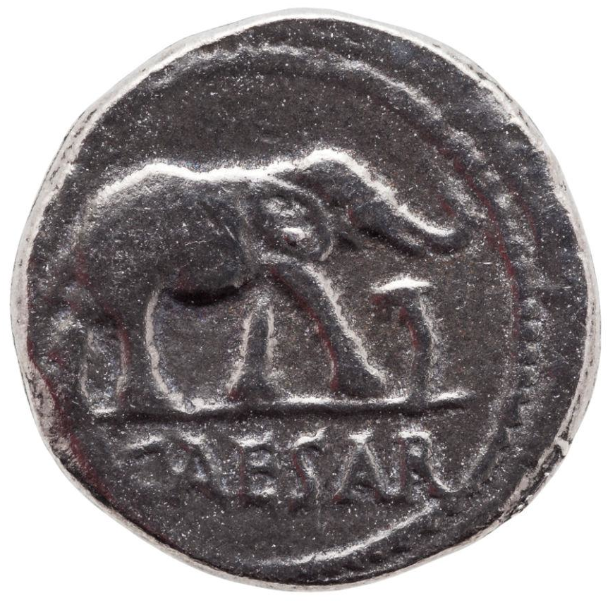
Side 1: Ephesians 4:29-32 ESV
²⁹ Let no corrupting talk come out of your mouths, but only such as is good for building up, as fits the occasion, that it may give grace to those who hear. ³⁰ And do not grieve the Holy Spirit of God, by whom you were sealed for the day of redemption. ³¹ Let all bitterness and wrath and anger and clamor and slander be put away from you, along with all malice. ³² Be kind to one another, tenderhearted, forgiving one another, as God in Christ forgave you.

Slide 9
Ephesians 4:29-32 ESV
²⁹ Let no corrupting talk come out of your mouths, but only such as is good for building up, as fits the occasion, that it may give grace to those who hear. ³⁰ And do not grieve the Holy Spirit of God, by whom you were sealed for the day of redemption. ³¹ Let all bitterness and wrath and anger and clamor and slander be put away from you, along with all malice. ³² Be kind to one another, tenderhearted, forgiving one another, as God in Christ forgave you.

Slide 10
Ephesians 4:29-32 ESV
²⁹ Let no corrupting talk come out of your mouths, but only such as is good for building up, as fits the occasion, that it may give grace to those who hear. ³⁰ And do not grieve the Holy Spirit of God, by whom you were sealed for the day of redemption. ³¹ Let all bitterness and wrath and anger and clamor and slander be put away from you, along with all malice. ³² Be kind to one another, tenderhearted, forgiving one another, as God in Christ forgave you.

Slide 11
Ephesians 4:29-32 ESV
²⁹ Let no corrupting talk come out of your mouths, but only such as is good for building up, as fits the occasion, that it may give grace to those who hear. ³⁰ And do not grieve the Holy Spirit of God, by whom you were sealed for the day of redemption. ³¹ Let all bitterness and wrath and anger and clamor and slander be put away from you, along with all malice. ³² Be kind to one another, tenderhearted, forgiving one another, as God in Christ forgave you.

Slide 12
Ephesians 4:29-32 ESV
²⁹ Let no corrupting talk come out of your mouths, but only such as is good for building up, as fits the occasion, that it may give grace to those who hear. ³⁰ And do not grieve the Holy Spirit of God, by whom you were sealed for the day of redemption. ³¹ Let all bitterness and wrath and anger and clamor and slander be put away from you, along with all malice. ³² Be kind to one another, tenderhearted, forgiving one another, as God in Christ forgave you.

Slide 13
Ephesians 4:29-32 ESV
²⁹ Let no corrupting talk come out of your mouths, but only such as is good for building up, as fits the occasion, that it may give grace to those who hear. ³⁰ And do not grieve the Holy Spirit of God, by whom you were sealed for the day of redemption. ³¹ Let all bitterness and wrath and anger and clamor and slander be put away from you, along with all malice. ³² Be kind to one another, tenderhearted, forgiving one another, as God in Christ forgave you.
Notes:
Clamor – noise + emotion kids referee
anger
👉 “Something isn’t right—and I feel it.”
Righteous un righteous measured not measured
Often reactionary
Wrath
👉 “I’m going to make this right—even if it destroys something.”
bitterness
👉 “I was wronged… and I’m not letting it go.”
🧠 Break it down
Hurt → something real happened
Remembered repeatedly → you replay it
Resentment grows → it hardens inside
👉 Bitterness = stored-up hurt that has turned into ongoing resentment

Slide 14
Ephesians 4:29-32 ESV
²⁹ Let no corrupting talk come out of your mouths, but only such as is good for building up, as fits the occasion, that it may give grace to those who hear. ³⁰ And do not grieve the Holy Spirit of God, by whom you were sealed for the day of redemption. ³¹ Let all bitterness and wrath and anger and clamor and slander be put away from you, along with all malice. ³² Be kind to one another, tenderhearted, forgiving one another, as God in Christ forgave you.

Slide 15
Ephesians 4:29-32 ESV
²⁹ Let no corrupting talk come out of your mouths, but only such as is good for building up, as fits the occasion, that it may give grace to those who hear. ³⁰ And do not grieve the Holy Spirit of God, by whom you were sealed for the day of redemption. ³¹ Let all bitterness and wrath and anger and clamor and slander be put away from you, along with all malice. ³² Be kind to one another, tenderhearted, forgiving one another, as God in Christ forgave you.

Slide 16
“Corrupting Talk”
Speech that tears people down instead of building them up.
Anything you say that makes things worse—hurts people, spreads negativity, or damages trust
rots relationships (gossip, backstabbing,)
cuts people down (insults, sarcasm with bite)
stirs trouble (complaining, stirring conflict)
pollutes the atmosphere (crude, bitter, or toxic talk)
Gas Lighting!

Slide 17
Summary
Anger → normal emotion - a momentary reaction
Wrath → anger exploding outward into action
Clamour → loud, emotional arguing
Slander → harmful false speech – (related to Gossip)
Malice → I want to hurt you in some way!
Bitterness → unforgiveness, the root inside that feeds the above

Slide 18
Paul’s Summary - Romans 12:10, 20 EVS
Love one another with brotherly affection. Out do one another in showing honour.

Slide 19
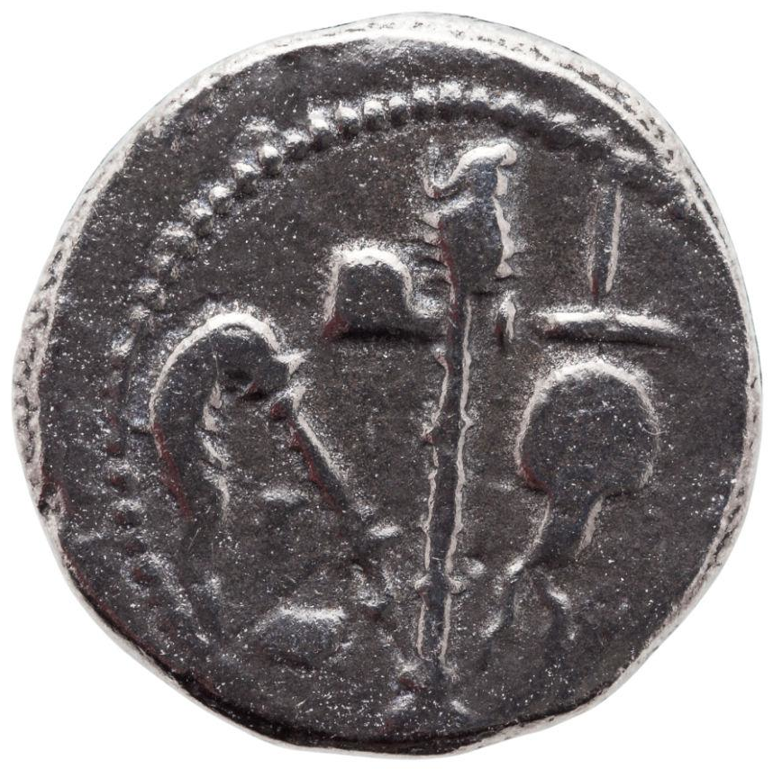
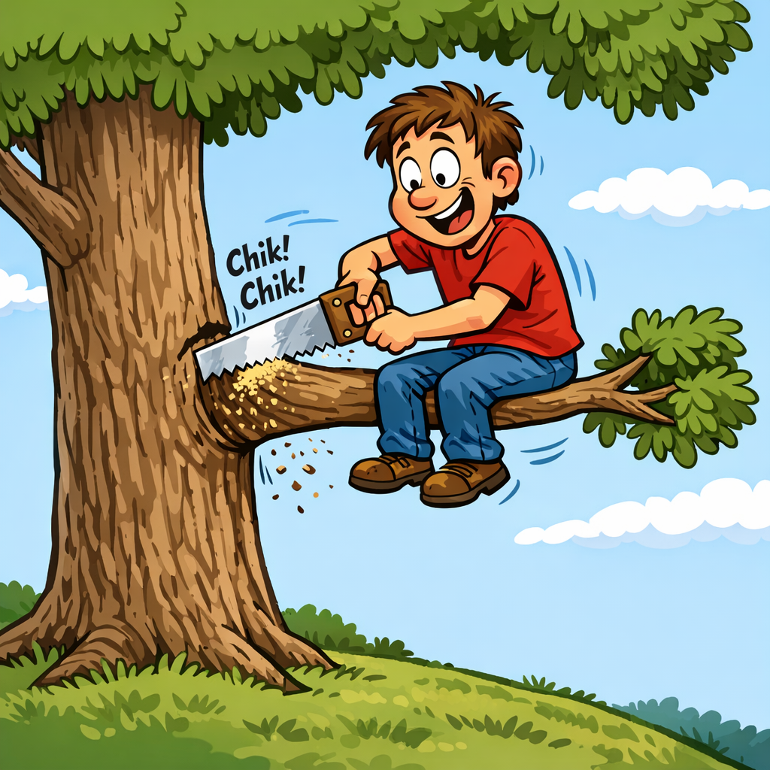
Side 2: James 3:1-11 ESV
🎯 Bullseye - “Every word you speak is either building the church… or burning it.”

Slide 20
James 3:1-11 ESV Taming the Tongue
3 Not many of you should become teachers, my brothers, for you know that we who teach will be judged with greater strictness. ² For we all stumble in many ways. And if anyone does not stumble in what he says, he is a perfect man, able also to bridle his whole body. ³ If we put bits into the mouths of horses so that they obey us, we guide their whole bodies as well. ⁴ Look at the ships also: though they are so large and are driven by strong winds, they are guided by a very small rudder wherever the will of the pilot directs. ⁵ So also the tongue is a small member, yet it boasts of great things.

Slide 21
James 3:1-11 ESV Taming the Tongue
3 Not many of you should become teachers, my brothers, for you know that we who teach will be judged with greater strictness. ² For we all stumble in many ways. And if anyone does not stumble in what he says, he is a perfect man, able also to bridle his whole body. ³ If we put bits into the mouths of horses so that they obey us, we guide their whole bodies as well. ⁴ Look at the ships also: though they are so large and are driven by strong winds, they are guided by a very small rudder wherever the will of the pilot directs. ⁵ So also the tongue is a small member, yet it boasts of great things.

Slide 22
James 3:1-11 ESV Taming the Tongue
3 Not many of you should become teachers, my brothers, for you know that we who teach will be judged with greater strictness. ² For we all stumble in many ways. And if anyone does not stumble in what he says, he is a perfect man, able also to bridle his whole body. ³ If we put bits into the mouths of horses so that they obey us, we guide their whole bodies as well. ⁴ Look at the ships also: though they are so large and are driven by strong winds, they are guided by a very small rudder wherever the will of the pilot directs. ⁵ So also the tongue is a small member, yet it boasts of great things.

Slide 23
James 3:1-11 Continued
How great a forest is set ablaze by such a small fire! ⁶ And the tongue is a fire, a world of unrighteousness. The tongue is set among our members, staining the whole body, setting on fire the entire course of life, and set on fire by hell…. ⁹ With it we bless our Lord and Father, and with it we curse people who are made in the likeness of God. ¹⁰ From the same mouth come blessing and cursing. My brothers, these things ought not to be so. ¹¹ Does a spring pour forth from the same opening both fresh and salt water?

Slide 24
James 3:1-11 Continued
How great a forest is set ablaze by such a small fire! ⁶ And the tongue is a fire, a world of unrighteousness. The tongue is set among our members, staining the whole body, setting on fire the entire course of life, and set on fire by hell…. ⁹ With it we bless our Lord and Father, and with it we curse people who are made in the likeness of God. ¹⁰ From the same mouth come blessing and cursing. My brothers, these things ought not to be so. ¹¹ Does a spring pour forth from the same opening both fresh and salt water?

Slide 25
Gossips - Romans 1:29-32
^{Definition of what is Gossip?}
²⁹ They were filled with all manner of unrighteousness, evil, covetousness, malice. They are full of envy, murder, strife, deceit, maliciousness. They are gossips, ³⁰ slanderers, haters of God, insolent, haughty, boastful, inventors of evil, disobedient to parents, ³¹ foolish, faithless, heartless, ruthless. ³² Though they know God's righteous decree that those who practice such things deserve to die, they not only do them but give approval to those who practice them.

Slide 26
Gossips - Romans 1:29-32
²⁹ They were filled with all manner of unrighteousness, evil, covetousness, malice. They are full of envy, murder, strife, deceit, maliciousness. They are gossips, ³⁰ slanderers, haters of God, insolent, haughty, boastful, inventors of evil, disobedient to parents, ³¹ foolish, faithless, heartless, ruthless. ³² Though they know God's righteous decree that those who practice such things deserve to die, they not only do them but give approval to those who practice them.

Slide 27
Gossip
Proverbs 16:28 - … and a whisperer separates close friends.
Proverbs 17:9 - Whoever covers an offense seeks love,
but he who repeats a matter separates close friends.
Matthew 12:36-37 - ³⁶ I tell you, on the day of judgment people will give account for every careless word they speak, ³⁷ for by your words you will be justified, and by your words you will be condemned.”

Slide 28
Gossip - The Solution
Proverbs 26:20 ESV
For lack of wood the fire goes out,
and where there is no whisperer, quarreling ceases.
Angle: Love isn’t tested when things are easy—it’s tested when you’ve been wronged.
Key: fast forgiveness, no score-keeping, no cold wars.

Slide 29
HOW?

Slide 30
Where is Wally?
Acts 2:³⁶ Let all the house of Israel therefore know for certain that God has made him both Lord and Christ, this Jesus whom you crucified.”
³⁷ Now when they heard this they were cut to the heart, and said to Peter and the rest of the apostles, “Brothers, what shall we do?” ³⁸ And Peter said to them, “Repent and be baptized every one of you in the name of Jesus Christ for the forgiveness of your sins, and you will receive the gift of the Holy Spirit. ³⁹ For the promise is for you and for your children and for all who are far off, everyone whom the Lord our God calls to himself.”

Slide 31
Galatians 5:22-23 ESV
²² But the fruit of the Spirit is love, joy, peace, patience, kindness, goodness, faithfulness,
²³ gentleness, self-control; against such things there is no law.

Slide 32
Conclusion
Speech Matters - Coin Eph 4 vs James 3
Build up others / Tame the tongue
Out do one another in honouring each other!
🎯 Bullseye - “Every word you speak is either building the church… or burning it.”
👉 “Who will you do this with this week — and who will ask you if you did it?”
Prayer - to hit this bullseye today!

