Slide 1
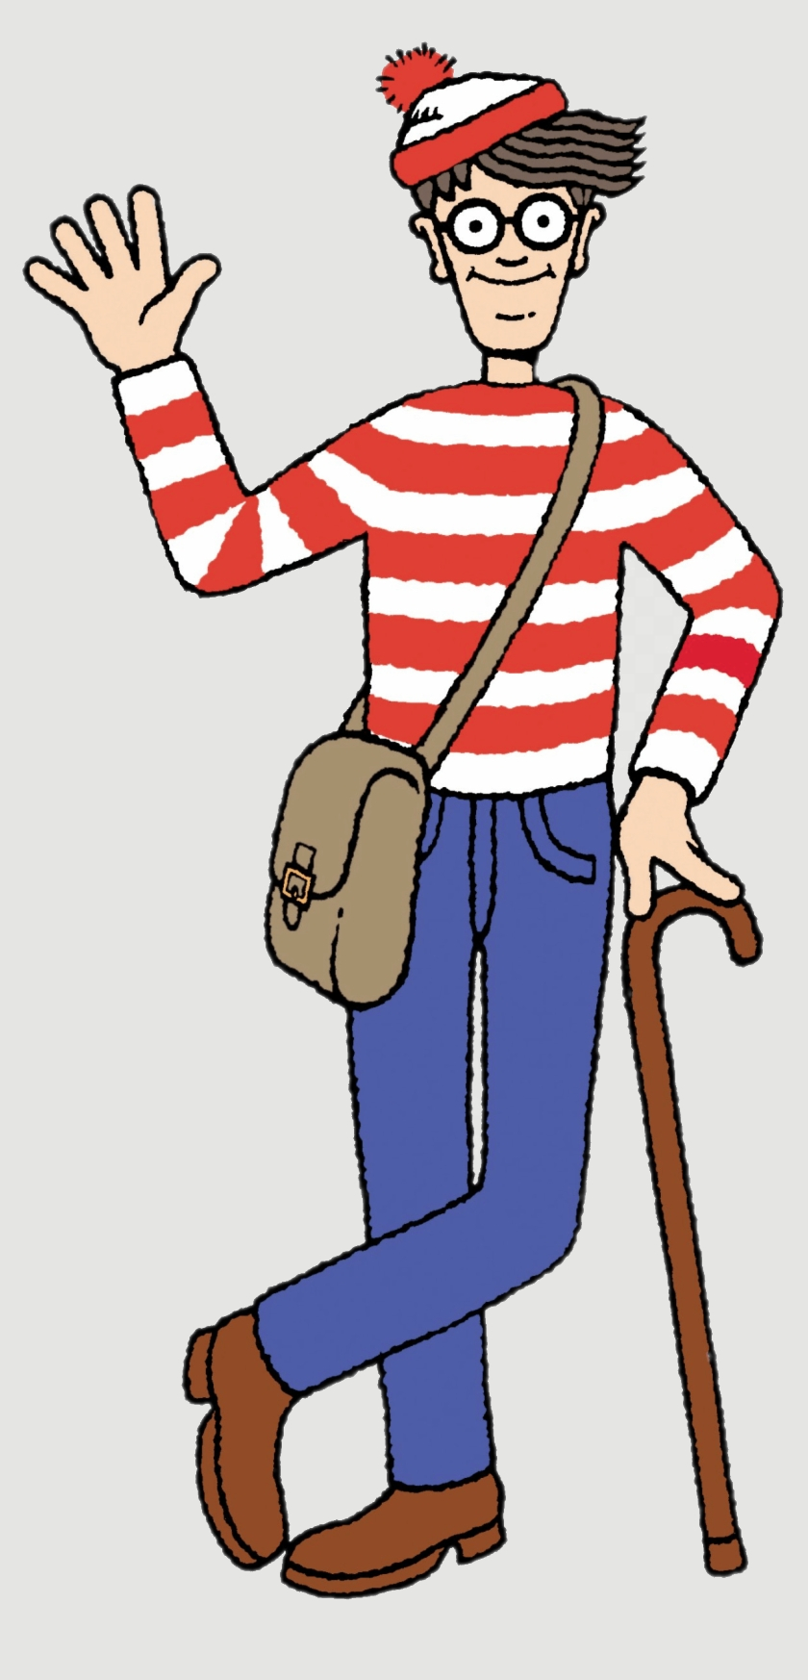
Every message in the Series will land the same way
Gospel, application, accountability.
A reference to Jesus and His good news
One clear practical application
One action to take this week
One person to share it with that was not here today
One close friend to spur you on and support each other in this task
Each will only help you grow stronger – no condemnation intended. (If you are struggling let me know.)
But… get comfortable with being uncomfortable
Love One Another | Forgiveness and Bearing with| Col 3/Eph 4

Slide 2
🔑 Message Series –
“…By this everyone will know that you are my disciples, if you love one another.” John 13:35
OVERALL QUESTION: What does Love “LOOK” like from the outside?
How will someone see that you “love one another”?
👉 Get your Journal out or you phone to take notes!

Slide 3
Today - #5: No Triangles
Today is for the Body of Christ, The Church, believers only. Not the world.
Love Goes Direct, Not Sideways
Matthew 18

Slide 4
Opening Prayer
Take us on a journey...
Open our hearts.
Stop us from being offended and start listening
Help us grow.
Help us get comfortable with being uncomfortable

Slide 5
Review
Every word you speak is either building the ‘Church’... Or burning it down. (Eph 4/James 3)
“Don’t do for someone what God is expecting them to do! But always help with what they cannot do alone.” (Gal 6)
Serve One Another (skipped for now Acts 2-4)
Bear with one another… forgive one another… and above all these put on love.
(Col 3:12–14, Eph 4:31–32)

Slide 6
📝 Take Note – last week
Forgiveness is commanded.
Reconciliation is desired.
Trust is earned.
Did you do it? I did!

Slide 7
Something Beautiful Is Happening
People are serving, helping and praying.
Keep it up.

Slide 8
But...
Conflict is not proof a church is unhealthy.
How we handle it can be.
🐂 Where there are no oxen, the manger is clean,
but abundant crops come by the strength of the ox. (Prov 14:4)
“A clean stable may look impressive, but it produces no harvest.”
Remember we are talking about disputes within the Church body. Believers!

Slide 9
Unrepented Sin
We talked about bearing with each other and forgiving each other.
We talked about how that does not mean that we call evil, good.
That we excuse and condone unrepented sin
What do we do then?

Slide 10
Today's Big Idea
Mature love moves toward people.
Immature love talks about people.
“If you're not part of the problem; or part of the solution – stop talking about it!”
What do you do if you are part of the problem or want to be part of the solution?

Slide 11
Two-sided Coin
Heads Tails
I Was Wronged I Did the Wrong
Matthew 18:15–17 Matthew 5:23–24
Go to them Go to them
Seek restoration Seek Reconciliation

Slide 12
Matthew 18:15-17
¹⁵ “If your brother sins against you, go and tell him his fault, between you and him alone. If he listens to you, you have gained your brother. ¹⁶ But if he does not listen, take one or two others along with you, that every charge may be established by the evidence of two or three witnesses. ¹⁷ If he refuses to listen to them, tell it to the church. And if he refuses to listen even to the church, let him be to you as a Gentile and a tax collector.

Slide 13
Matthew 18:15-17
¹⁵ “If your brother sins against you, go and tell him his fault, between you and him alone. If he listens to you, you have gained your brother. ¹⁶ But if he does not listen, take one or two others along with you, that every charge may be established by the evidence of two or three witnesses. ¹⁷ If he refuses to listen to them, tell it to the church. And if he refuses to listen even to the church, let him be to you as a Gentile and a tax collector.

Slide 14
Matthew 18:15-17
¹⁵ “If your brother sins against you, go and tell him his fault, between you and him alone. If he listens to you, you have gained your brother. ¹⁶ But if he does not listen, take one or two others along with you, that every charge may be established by the evidence of two or three witnesses. ¹⁷ If he refuses to listen to them, tell it to the church. And if he refuses to listen even to the church, let him be to you as a Gentile and a tax collector.

Slide 15
Matthew 18:15-17
¹⁵ “If your brother sins against you, go and tell him his fault, between you and him alone. If he listens to you, you have gained your brother. ¹⁶ But if he does not listen, take one or two others along with you, that every charge may be established by the evidence of two or three witnesses. ¹⁷ If he refuses to listen to them, tell it to the church. And if he refuses to listen even to the church, let him be to you as a Gentile and a tax collector.

Slide 16
Matthew 5:23-24
²³ So if you are offering your gift at the altar and there remember that your brother has something against you, ²⁴ leave your gift there before the altar and go. First be reconciled to your brother, and then come and offer your gift.

Slide 17
Matthew 5:23-24
²³ So if you are offering your gift at the altar and there remember that your brother has something against you, ²⁴ leave your gift there before the altar and go. First be reconciled to your brother, and then come and offer your gift.

Slide 18
Matthew 5:23-24
²³ So if you are offering your gift at the altar and there remember that your brother has something against you, ²⁴ leave your gift there before the altar and go. First be reconciled to your brother, and then come and offer your gift.

Slide 19
Matthew 5:23-24
²³ So if you are offering your gift at the altar and there remember that your brother has something against you, ²⁴ leave your gift there before the altar and go. First be reconciled to your brother, and then come and offer your gift.

Slide 20
Matthew 18:15
Go and tell them their fault...
between you and him alone.
Escalate it if required

Slide 21
Matthew 5:23-24
Stop what you are doing immediately…
Go and fix your mess
If possible, so far as it depends on you, live peaceably with all. (Romans 12:18)

Slide 22
Go To Them straight away
Don't Go Around Them

Slide 23
What if they still will not listen?
1 Corinthians 6:1-7
When one of you has a grievance against another, does he dare go to law before the unrighteous instead of the saints?...
⁴ So if you have such cases, why do you lay them before those who have no standing in the church? ⁵ I say this to your shame. Can it be that there is no one among you wise enough to settle a dispute between the brothers, ⁶ but brother goes to law against brother, and that before unbelievers? ⁷ To have lawsuits at all with one another is already a defeat for you. Why not rather suffer wrong? Why not rather be defrauded?

Slide 24
The Triangle
Talking about people instead of talking to people.
“The problem is not being discussed with the person/s involved. It is being discussed with everyone else.”
Examples:
  Complaining
  "Prayer requests" that are really rumours
  Gossip
  Recruiting allies

Slide 25
Person C
(the actual issue)
/ \
/ \
/ \
/ \
/ \
/ \
/ \
/ \
/ \
😟
😕
Person A
😐
Person B

Slide 26
Why Triangles Feel Good
Fear Avoidance - lets me talk about the problem without risking the relationship.
Safety - Recruiting -A crowd feels safer than a conversation, Manipulation (pseudo votes)!
Validation - When I'm upset, I want someone to tell me I'm right.
Protection – don’t want to hurt their feelings
Pride - Wise one, All knowing one, Connected one
Victim - attention, Justified
Notes:
They might get angry. They might reject me. They might disagree. I might be wrong.

Slide 27
The Real Reason
Triangles feel good because they give us the benefits of conflict without the risks of conflict.
  You get:
  Temporary relief
  validation
  support
  safety
Without:
  courage
  humility
  vulnerability
  Reconciliation

Slide 28
For a while until it all goes BANG 💥

Slide 29
📝 Take Note - Crux
"Triangles temporarily relieve tension. Direct conversations resolve tension."

Slide 30
But They Never Solve The Problem
The conflict grows.
The audience grows.
The hurt grows.
🔥🔥Churches split or
die a cold death❄️

Slide 31
What Gossip Sounds Like
Christianese Gossip:
'Can I share this for prayer?'
'I just need advice...’
‘I just thought as leadership you should know…’ (When they have not attempted to go directly to the person first.)

Slide 32
The Gospel
When we sinned against God...
God did not:
gossip about us
avoid us
write us off
wait for us to fix ourselves
Instead...
“For God so loved the world, that he gave his only Son, that whoever believes in him should not perish but have eternal life. (John 3:16)
"While we were still sinners, Christ died for us." (Rom 5:8)
👉 God moved toward us. He directly went to us.

Slide 33
The Cross
The cross is God moving toward His enemies.
At great cost.
Not because we deserved it.
Not because we were easy to love.
But because that is what love does.
👉 Love goes first. Love goes direct!
Last Week
The cross is forgiveness with nails in it.
This week:
The cross is reconciliation with nails in it.

Slide 34
How to do this properly
First – Be safe. Be Wise. (Some situations need mediation, a referee, or a witness at least)
Example: Active current abuse of a serious nature
Then…

Slide 35
Slow down
Pray before reacting
Go to them!!
Stay humble (God forgave you of worse)
Ask questions first
Assume less
Listen longer
Seek understanding.

Slide 36
Don't Go Around Them
Don't recruit allies.
Don't build teams.
Don’t just avoid them.

Slide 37
The Goal Is Restoration
Win your brother back.
Not win the argument.

Slide 38
Practical Example - Church
The carpark conversation.
The side meeting.
Coffee Shop
Well thought out gentle letter/email
🚫Facebook Messenger, text, post

Slide 39
Real Love Costs
Last week: absorbs cost.
This week: goes first.

Slide 40
Two Ditches
Avoidance
Attack
Choose courage instead.

Slide 41
Diagnostic Questions
Who am I talking about instead of to?
Who am I avoiding?
1. Am I part of the problem?
2. Do I want to be part of the solution?
If you’re not one of the two above, then Stop talking!

Slide 42
📝 Take Note
Mature love moves toward people.
Seeks restoration.

Slide 43
Call To Action
This week:
Pick One relationship
Take One step toward someone.
Try to Have One conversation..

Slide 44
Loving Accountability
Who will you share this with that was not here today?
Who will ask you if you did it, or not?
Remember the rope last week?

Slide 45
Conclusion
Mature love moves toward people.
Refuses gossip.
Tells the truth with grace.

Slide 46
Final Line
Love goes direct.
Love goes first.

Slide 47
Closing Prayer
Lord, teach us to love each other like You loved us.

