Slide 1
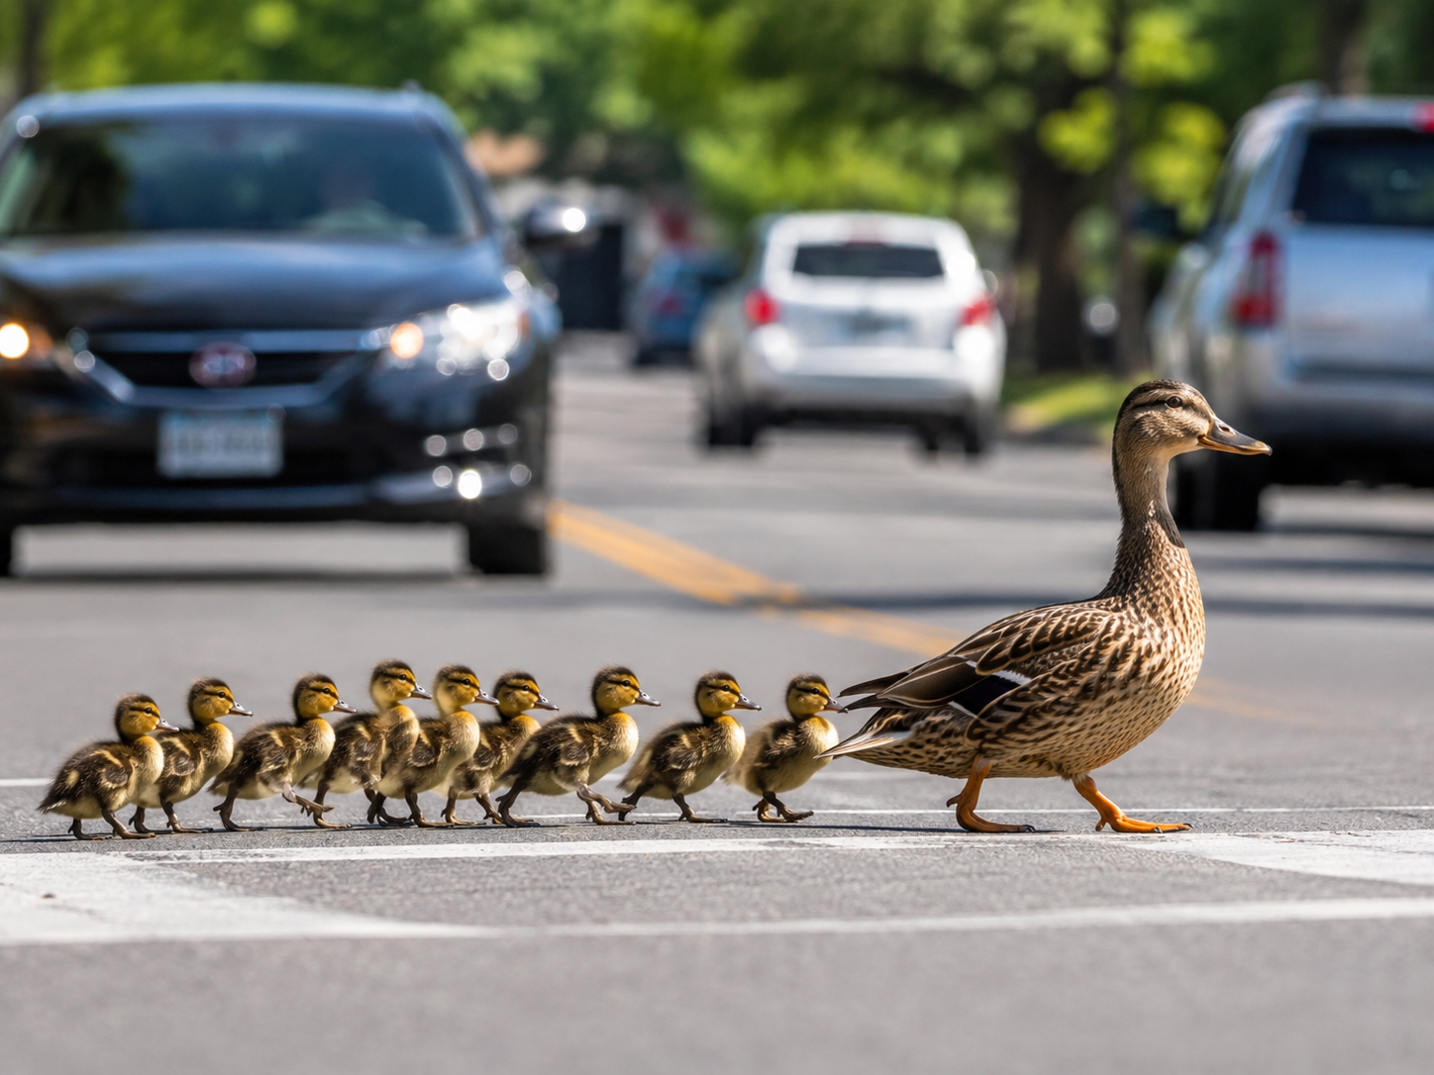
VISION CAST
FOLLOW FAITHFULLY. HELP THE ONE BEHIND.
Every disciple has a part to play.
Notes:
Use the duck family as a simple vision cast. Jesus is the one we all follow. Mature disciples also help the person behind them keep moving. The analogy is limited: no disciple replaces Jesus.

Slide 2
VISION CAST
What the Ducks Remind Us
KEEP MOVING
LOOK BACK
KEEP JESUS IN VIEW
Who is behind me?
How can I help them keep moving?
Following is active.
A disciple takes the next step.
Stay behind the one in front.
Notes:
The goal is not a chain of dependency. The goal is a culture where every person follows Jesus and also notices the person around them.

Slide 3
SERIES 1 Review
LOOK BACK — Love One Another
What did visible love look like?
SPEAK LIFE
HELP WISELY
FORGIVE
GO DIRECT
GO LOW
BUILD COURAGE
MAKE SPACE
FIGHT FOR UNITY
SPUR ONE ANOTHER ON
LOVE BECAME VISIBLE.
Notes:
This is the briefest possible summary of Series 1. Remind people that the point was behaviour, not merely knowledge.

Slide 4
WHERE ARE WE GOING?
The Bridge
1. LOVE ONE ANOTHER
2. FOLLOW ME
3. HELP ONE PERSON
Healthy family
Relational soil laid.
→
Obedient disciple
Starting now.
→
Disciple-maker
Coming next.
We learned how disciples live together. Now we learn how disciples follow Jesus.
Notes:
Do not rush the DMM method. This is the culture road map: healthy family, obedient disciple, then disciple-maker.

Slide 5
SERIES 2
FOLLOW ME — The New Question
What does it actually LOOK like to follow Jesus?
Not just believe.
Not just attend.
FOLLOW.
Notes:
Make the change of question explicit. The old question was what visible love looks like. The new question is what following Jesus actually looks like.

Slide 6
FOLLOW ME
The Series Anchor
FOLLOW ME
I WILL MAKE YOU
FISHERS OF PEOPLE
relationship
+ obedience
Jesus
transforms us
help others
follow
→
→
“Follow Me, and I will make you become fishers of men.” — Mark 1:17
Notes:
This sentence gives the whole series direction: relationship/obedience, transformation, and outward mission.

Slide 7
OUR SIMPLE RHYTHM
How Every Week Will Work
HEAR IT
OBEY IT
PASS IT ON
CHECK IN
→
→
→
What did Jesus say?
What will I do?
Who could benefit?
Who will help me follow through?
HEAR IT → OBEY IT → PASS IT ON → CHECK IN
Truth should move from the sermon into life — and from us into someone else.
Notes:
This is the practical mechanism for every sermon in the series. Repeat this language often until it becomes normal.

Slide 8
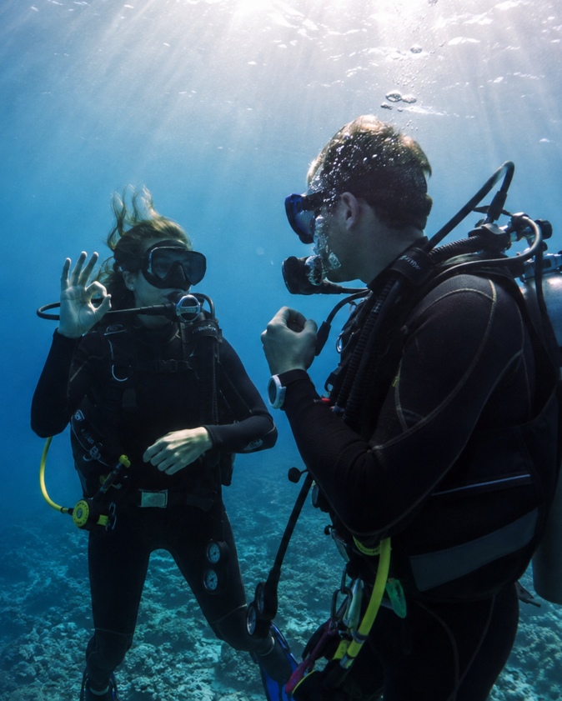
SCUBA BUDDY
NEVER DIVE ALONE.
Your buddy…
• checks in (not checks up)
• watches your back
• helps when you get stuck
• encourages you to keep moving
Get one!
Be one!
Ecclesiastes 4:9–10
Notes:
Use this instead of leading with the word accountability. A scuba buddy does not dive for you. They stay close, notice danger, encourage, and receive the same support in return.

Slide 9
HOT POTATO
PASS IT ON
Do not let truth die in your notebook.
1
→
2
→
3
→
4
If someone could benefit from one thing you learned — and they were not here — tell them.
“Entrust [it] to faithful people who will be able to teach others also.” — 2 Timothy 2:2
Notes:
Use the Hot Potato language lightly: truth is meant to be passed on, not kept. The point is simple reproduction, not expertise.

Slide 10
DO SOMETHING WITH IT
OBEDIENCE CHALLENGE
DON’T JUST TAKE NOTES. TAKE A STEP.
ONE ACTION
ONE PERSON
ONE FOLLOW-UP
Choose one clear step.
Tell someone what you will do.
Report back next time.
Next time: report • celebrate • learn • keep moving
James 1:22 — “Be doers of the word…”
Notes:
Make clear that the challenge is not a test of worth. It is simply a way to stop sermons ending as information only.

Slide 11
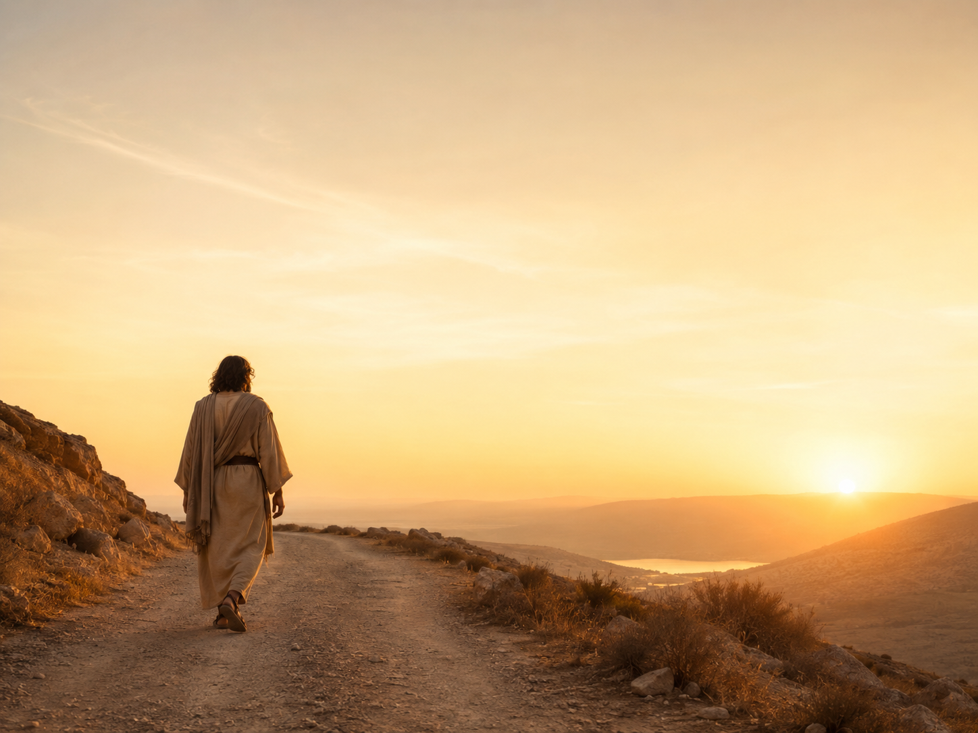
FOLLOW ME #1
NO SPECTATORS
Mark 1:16–20 • Matthew 4:18–22
Notes:
Main sermon title.

Slide 12
FOLLOW ME #1
Opening Prayer
Take us on a journey.
Open our hearts.
Help us stop being spectators.
Help us obey quickly when Jesus calls.
Help us get comfortable with being uncomfortable.
Notes:
Pray slowly. Ask God to move the room from hearing to following.

Slide 13
FOLLOW ME #1
Today’s Big Idea
JESUS CALLS FOLLOWERS, NOT FANS.
A disciple does not merely agree with Jesus.
A disciple moves.
Notes:
Repeat this several times through the sermon. It is one of the take-home lines.

Slide 14
Jesus Begins His Ministry
¹⁴ Now after John was arrested, Jesus came into Galilee, proclaiming the gospel of God, ¹⁵ and saying, “The time is fulfilled, and the kingdom of God is at hand;^{[a]} repent and believe in the gospel.”
Jesus Calls the First Disciples
¹⁶ Passing alongside the Sea of Galilee, he saw Simon and Andrew the brother of Simon casting a net into the sea, for they were fishermen. ¹⁷ And Jesus said to them, “Follow me, and I will make you become fishers of men.”^{[b]} ¹⁸ And immediately they left their nets and followed him. ¹⁹ And going on a little farther, he saw James the son of Zebedee and John his brother, who were in their boat mending the nets. ²⁰ And immediately he called them, and they left their father Zebedee in the boat with the hired servants and followed him.

Slide 15
MARK 1:14–15
The Kingdom Arrives
“The time is fulfilled, and the kingdom of God is at hand; repent and believe in the gospel.”
Mark 1:15
Jesus does not begin with a hobby. He announces a King and calls for a response.
Notes:
Set the context. Follow Me comes immediately after Jesus announces the Kingdom and calls people to repent and believe.

Slide 16
MARK 1:16–17
The Call
“Follow Me, and I will make you become fishers of men.”
Mark 1:17
FOLLOW ME → I WILL MAKE YOU → FISHERS OF PEOPLE
Notes:
This is both the sermon text and the series sentence.

Slide 17
MARK 1:18
The Response
TAKE NOTE
They did not just agree with Jesus.
“Immediately they left their nets and followed Him.”
Mark 1:18
Notes:
Emphasise the action word: immediately. Agreement becomes following when it moves the feet.

Slide 18
MARK 1:19–20
The Call Repeats
“Immediately He called them, and they left their father Zebedee in the boat… and followed Him.”
Mark 1:20
Different men. Same Jesus. Same kind of response!
Notes:
James and John reinforce the pattern: Jesus calls, disciples respond.

Slide 19
THE PATTERN
TAKE NOTE
WHEN JESUS IS CLEAR, DISCIPLES MOVE.
Not perfectly. Not recklessly. But they do not make delay their lifestyle.
Notes:
This is the key memorable learning line from the text.

Slide 20
“IMMEDIATELY”
Mark Moves Fast
More than 40 times Mark uses a Greek word often translated:
IMMEDIATELY • AT ONCE • STRAIGHTAWAY
Immediately — Jesus comes from the water. (1:10)
Immediately — the Spirit drives Him into the wilderness. (1:12)
Immediately — Simon and Andrew leave their nets. (1:18)
Immediately — James and John are called. (1:20)
Mark tells the story with urgency.
Notes:
The exact English rendering varies, but Mark repeatedly uses euthys/eutheos language. Do not claim every occurrence means an instantaneous ethical response; the narrative effect is urgency.

Slide 21
PROMPT OBEDIENCE
“Immediately” Does Not Mean Reckless
It does not mean acting without wisdom.
It means Jesus is not put at the bottom of the list.
It means we do not endlessly postpone what He has made clear.
Delayed obedience can quietly become disobedience.
The issue is not speed for speed’s sake. The issue is who has first place.
Notes:
Clarify the distinction between prompt obedience and rashness.

Slide 22
PERSONAL DIAGNOSTIC
What Net Is Still in Your Hands?
The net is not necessarily something bad.
It is anything I refuse to put down when Jesus says, “Follow Me.”
What am I holding onto that is delaying my obedience?
COMFORT
CONTROL
FEAR
PREFERENCE
REPUTATION
DELAY
Notes:
The disciples’ nets were their normal livelihood, not something sinful. The diagnostic is about what we cling to when Jesus calls us forward.

Slide 23
WHAT DOES FOLLOWING MEAN?
“Follow Me” Is Not Casual
Jesus has first place.
I learn His ways.
I obey with my feet — not just agree in my head.
My life begins to revolve around Him.
FOLLOWING IS A LIFE, NOT AN EVENT.
Notes:
Following Jesus is personal allegiance and daily direction, not merely attendance at Christian events.

Slide 24
CONSUMER CHRISTIANITY
Jesus Did Not Say…
ATTEND ME.
ADMIRE ME.
CONSUME WHAT CHURCH PROVIDES.
CRITIQUE FROM THE SEAT.
HE SAID: “FOLLOW ME.”
Notes:
Contrast consumer church habits with Jesus’ direct call without attacking people personally.

Slide 25
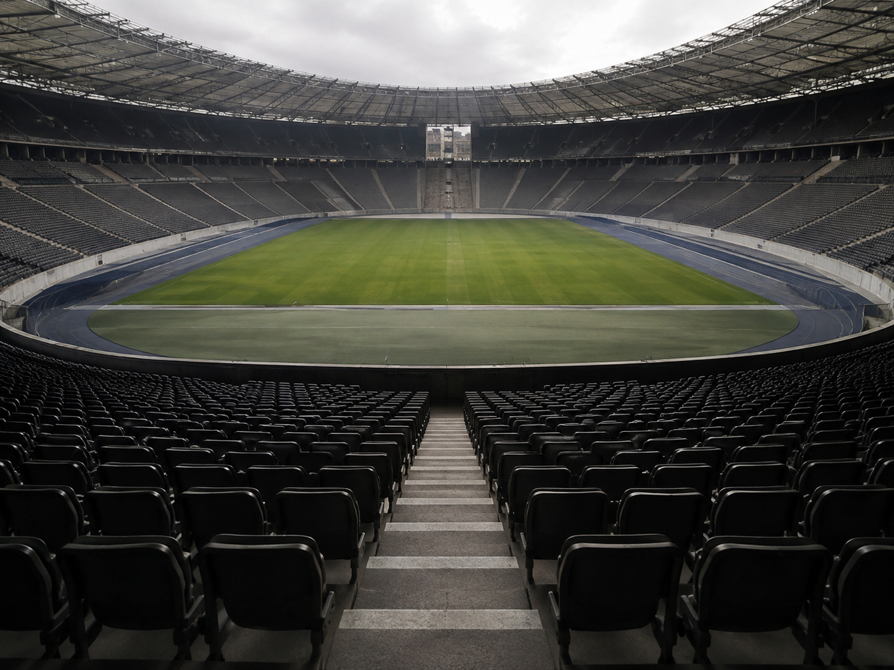
THE WORLD TRAINS SPECTATORS.
WATCH. COMMENT. CRITIQUE. CONSUME.
WAIT FOR SOMEONE ELSE.
Notes:
Use the stadium as the main spectator image. Do not overuse it elsewhere.

Slide 26
DIAGNOSTIC
Spectator Christianity vs Follower Life
SPECTATORS SAY…
FOLLOWERS ASK…
I attended.
I listened.
I liked / disliked it.
I agree / disagree.
Someone should do something.
What did Jesus say?
What will I obey?
Who can I help?
Who will help me follow through?
Which side sounds most like me?
Notes:
Let the room diagnose itself. Avoid shame; invite movement.

Slide 27
TAKE NOTE
The Kingdom Has No Spectators
JESUS CALLS EVERY DISCIPLE ONTO THE FIELD.
Not because we are impressive. Because He is Lord.
And love cares enough to help the people around us.
Notes:
This is the pastoral landing of the spectator section.

Slide 28
JESUS TRANSFORMS FOLLOWERS
“I Will Make You”
Two-Sided Coin
MY JOB IS TO FOLLOW.
HIS JOB IS TO MAKE ME.
Discipleship is not self-improvement by sheer effort.
As we follow, Jesus changes our character, priorities and direction.
Notes:
Keep the responsibility in the right place: we follow; Jesus transforms. This guards against legalism and self-reliance.

Slide 29
FOLLOWING TURNS OUTWARD
“Fishers of People”
FOLLOWING JESUS TURNS US TOWARD PEOPLE.
The disciple who follows Jesus begins helping other people follow Him too.
LOVE CARES ENOUGH TO HELP.
Family • friends • neighbours • workmates • church family
Notes:
This gently seeds the next DMM stage without rushing terminology.

Slide 30
JESUS CAME FIRST
The Gospel Fits the Message
Before Jesus called us to follow Him,
He came to seek and save us.
Luke 19:10
He did not shout directions from a distance.
He came near. He sought us. He went to the cross. He rose again.
GRACE MOVES FIRST.
Notes:
Make the Gospel directly relate to following. Jesus came to us first; our following is a response to grace, not a way to earn grace.

Slide 31
THE GOSPEL
The Good News of Jesus Christ
Our sin separates us from God.
Jesus came to seek and save the lost.
Christ died for our sins and was buried.
God raised Him from the dead.
Forgiveness and new life are offered through repentance and faith.
Mark 1:15 • 1 Corinthians 15:3–4
Notes:
Keep the Gospel clear and simple.

Slide 32
KEEP THE ORDER RIGHT
Grace & Obedience
WE DO NOT OBEY TO EARN SALVATION.
Salvation is the gift that makes following possible.
We obey because Jesus is Lord,
and because grace has brought us home.
We do it out of gratitude and love!
GRACE SAVES. FOLLOWERS OBEY.
Notes:
This is the theological guardrail: obedience follows grace.

Slide 33
FOLLOW ME #1
This Week’s Question
WHAT IS JESUS ASKING ME TO OBEY?
Not ten things. One clear next step.
Notes:
Pause here. Give the congregation time to think and write one thing down.

Slide 34
OBEY & REPORT
This Week’s Challenge
ONE ACTION
ONE PERSON
ONE FOLLOW-UP
Choose one clear thing from today that Jesus is asking you to do.
Tell your scuba buddy what you intend to do.
Ask them to check in — then report next time.
TRY TO ACT WITHIN 48 HOURS.
Prompt obedience turns dead sermons into discipleship.
Notes:
This is the weekly practice. Keep it concrete, achievable, and reportable.

Slide 35
WHO WASN’T HERE?
Hot Potato — Pass It On
Who could benefit from ONE thing you learned today?
Tell them before next time.
PASS
Useful truth should keep moving.
Notes:
Keep this short. The aim is to make sharing ordinary and reproducible.

Slide 36
WHAT DO I NEED TO REMEMBER?
TAKE NOTE — FOLLOW ME #1
Jesus calls followers, not fans.
When Jesus is clear, disciples move.
The “net” is anything I refuse to put down when Jesus says, “Follow Me.”
My job is to follow. His job is to make me.
Grace moves first. Followers obey.
Hear it. Obey it. Pass it on. Check in.
(There are hidden easter eggs on the slides online)
HEAR IT → OBEY IT → PASS IT ON → CHECK IN
Notes:
Read these lines slowly. This is the home-memory slide. Encourage people to photograph it or write it down.

Slide 37
FOLLOW ME #1
Closing Prayer
Lord Jesus,
when You call, help us follow you.
Show each of us one clear step.
Give us grace to obey quickly.
Help us pass on what we learn.
Make us disciples who help others follow You.
Amen
Notes:
Closing prayer.

Slide 38
REFERENCE
Matthew 4:18–22 — Parallel Call
18 While walking by the Sea of Galilee, Jesus saw Simon Peter and Andrew casting a net.
19 “Follow me, and I will make you fishers of men.”
20 Immediately they left their nets and followed him.
21–22 James and John likewise left the boat and their father and followed Him.

Slide 39
REFERENCE
Luke 9:23 — Daily Following
“If anyone would come after Me, let him deny himself and take up his cross daily and follow Me.”
Following is not a one-off emotional moment. It becomes a daily pattern of surrender and obedience.

Slide 40
REFERENCE
Mark’s “Immediately” Language
Mark repeatedly uses Greek εὐθύς / related adverbial forms often translated “immediately,” “at once,” or “straightway.”
Selected Mark 1 examples: 1:10, 1:12, 1:18, 1:20.
Teaching caution: the word often creates narrative urgency; it does not make every event an ethical command to act rashly. In 1:18 and 1:20, however, prompt response to Jesus’ call is explicit.

Slide 41
REFERENCE
Avoid the Two Ditches
DELAY
“Later.”
“When I feel ready.”
“When life settles down.”
Using spiritual-sounding language to postpone what Jesus has already made clear.
NOISE
Religious busyness.
Big talk, little obedience.
Activity without surrender.
A fan-club rather than a following life.

Slide 42
REFERENCE
Scripture Behind the Weekly Rhythm
SCUBA BUDDY / CHECK IN
Ecclesiastes 4:9–10; Hebrews 10:24–25
PASS IT ON
2 Timothy 2:2; Colossians 3:16
OBEY IT
James 1:22; Matthew 7:24–27
The mechanism is simple: hear truth, obey truth, share truth, and let someone walk with you.

Slide 43
REFERENCE
Practical Obedience Examples
A next step might be:
• forgive someone and stop rehearsing the offence
• go directly to someone instead of around them
• begin a simple daily Scripture-and-prayer rhythm
• encourage one person toward obedience
• tell someone what Jesus has done for you
• serve a person you normally overlook
The challenge is not to do everything. Choose one clear next step.

